Slide 1
Automating the Bechdel Test
Alec Naidoo, Zachary Fenton
DATASCI266 - Natural Language Processing
Section 002
Notes:
Thank you for joining us. For our project, we decided to take on the task of automating the Bechdel test with a machine learning approach.

Slide 2
Intro - Zach
Background - Alec
Data - Zach
motivation/model - Alec - combining with background to save time - should we skip model intro?
Bert models - Zach
Coref - Alec
results/discussion - Zach
Future work/recap - Alec

Slide 3
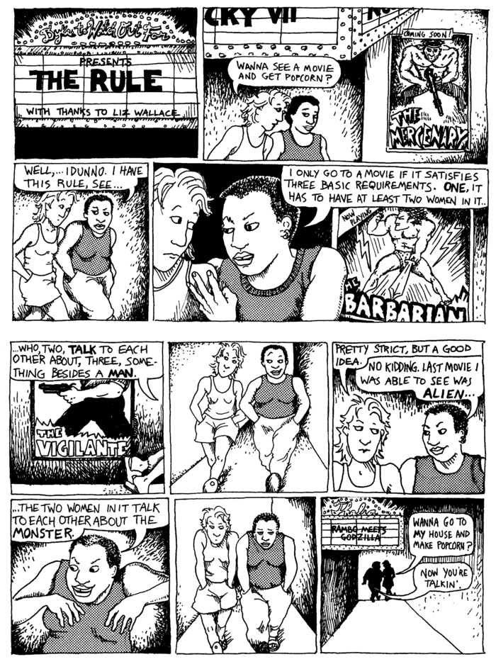
The Bechdel Test
->Web comic, Dykes to Watch Out For
“The Rule”
Alison Bechdel
1985
3 criteria
Must have two named female characters.
The two characters have to talk to each other.
And they must discuss something other than a man.
Notes:
The Bechdel Test comes from a 1985 comic stip created by Alison Bechdel and specifically focuses on female representation in movies. In order to successfully pass the test, a movie must meet three criteria; first, there must be two named female characters, the two characters must talk to each other. And finally, they must speak to each other about something other than a man. This test is very rudimentary, especially when you consider its creation; however, academia is increasingly using it as an indicator for the portrayal of women in media. Building off of previous work, our goal was to automate the Bechdel test utilizing machine learning.
Alec

Slide 4
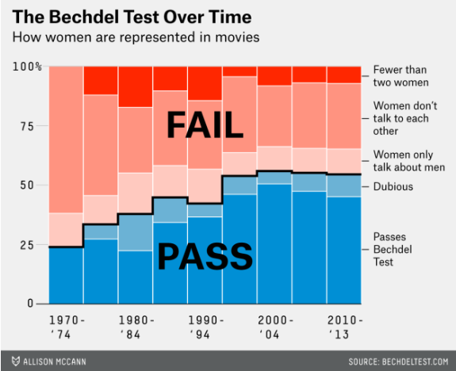
Background/Motivation
Why is the Bechdel Test important?
Simple measure of women’s representation in film
Tracks gender equity in film over time
Reverse Bechdel Test passes 95% (2023)
High association with ROI + IMDb Scores-
Hickey (2014) and Appel, Gnambs (2023)
Automation can improve the efficiency and accuracy for humans scoring the criteria
Disclaimers:
This test categories gender into a binary, which is not representative of non-binary and other gender diverse individuals
This test is only one metric of women’s representation in film, and is not all encompassing
Notes:
Easy to Understand
Data shows that movies pass the bechdel test around that level, where research has also shown that Reverse Bechdel Test passes 95% (Appel, Gnambs (2023)) -> big gap in men and women’s representation in film.
ROI + Box Office Performance Improvement - Hickey (2014) and Appel, Gnambs (2023) -> Tool for advocacy, and can be used to help films understand the importance of gender equity to the public, reflected financially.
The test has so much potential, and can be better implemented (and improved) by automation through modern NLP techniques.
Disclaimers
This test categories gender into a binary, which is not representative of non-binary and other gender diverse individuals
If it doesn’t pass the Bechdel Test, it doesn’t mean that a woman did not have a strong role in the film and if does, it doesn’t mean that the film is completely representative of gender equity.

Slide 5
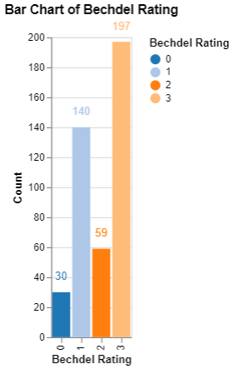
Data
-> Original Data: https://huggingface.co/datasets/mocboch/movie_scripts/tree/main
Raw Data:
426 movie scripts, each with a corresponding rating (0 to 3)
Movie scripts pulled from IMSDb (Internet Movie Script Database)
Ratings are pulled from bechdeltest.com
Parser
Consistent screenplay format issues
Standardize screenplays
Focus on dialogue
Scene detection.
Notes:
Our raw data set comes from Hugging face. The dataset consists of 426 scripts each with a corresponding bechdel rating. The movie scripts are pulled from the internet movie script database and the bechdel score is pulled from bechdel test dot com. To resolve class imbalances, we adjusting the ratings to a binary scale, 0, 1, and 2 are failing, and a 3 is a pass. Screenplays are written and printed in a standard format, however, publicly available screenplays sometime stray from this; they may have watermarks, the camera direction may or may not be present, the headings can change. We wanted to reduce the inconsistencies in screenplays in order to take attention away from those inconsistencies and focus on the dialogue.

Slide 6
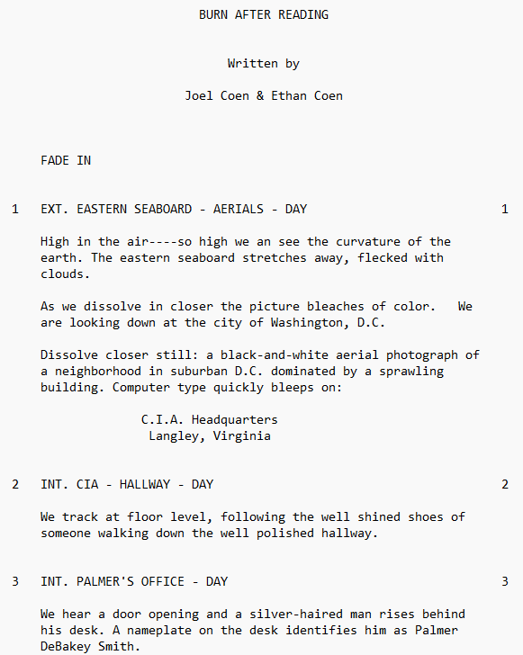
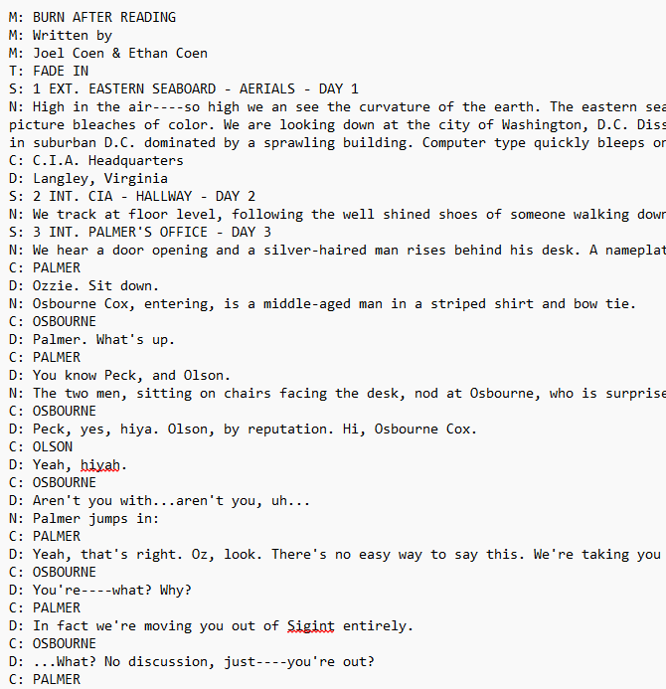
Parser
Work of Baruah et al.
Two types of parsers are developed:
Rules based
Robust
Robust utilized machine learning
Notes:
Baruah et al. developed 2 approaches for parsing screenplays. A rules based and a robust approach. We applied to robust approach which uses machine learning to produce a list of tags for each line of the screen play. The screenplay here is a standard screenplay for the movie Burn After Reading. Notice the direction heading (fade in) as well as scene description and camera cues. After parsing the screenplay will look more like this. Extra spaces are removed, formatting is made to be more consistent. I want to specifically point out the tags of each line here. Once we had parsed the scripts, we did initial EDA, cleaned the data, removed any duplicates and outlies and our final data set had 414 screenplays to work with.

Slide 7
BERT Models with Chunking
Model | Parameters | Layer | Hidden | Reasoning
bert-base-cased | 110 million | 12-layer | 768-hidden | Proof of concept Standard BERT model for classification
bert-large-cased | 340 million | 24-layer | 1024-hidden | Able to handle more complex tasks
bert-base-cased- finetuned-mrpc | 110M | 12-layer | 768-hidden | Sentence similarities (paraphrase / semantic)
Notes:
Our first approach was a BERT approach. We chose BERT because its ubiquitous baseline for NLP tasks (BERT (language model) - Wikipedia) and it is a robust model for classification. We applied 3 pre-trained models to our data set: The standard bert base cased. This model was a proof of concept as well as it being the standard bert model for classification. The next was the Bert large cased. This model is much larger and is able to handle more complex tasks. Finally, we used the bert base cased fine-tuned MRPC. The model is fine-tuned on the GLUE-MRPC dataset and specific determining whether paraphrasing or semantic similarities exist between sentences. The idea was this could be applied to dialogue and conversation understanding.
One restriction with the BERT models is the max token size. BERT’s max token size is 512 tokens, where as the average script length is 24,000 words. To get past this limit we applied a hierarchical chunking method that breaks the scripts down into segments of 512 tokens in length that can be fed through the model each until the entire script is contextualized. Aside from the BERT approach, we also used a coreference resolution model which Alec will go over.

Slide 8
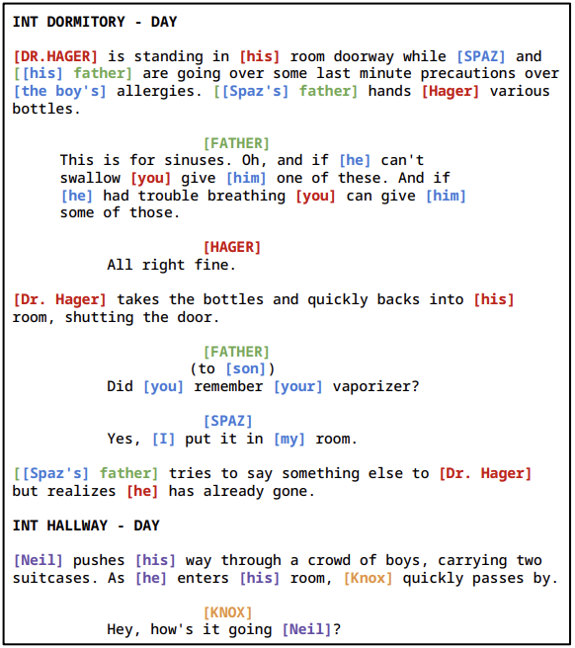
Coreference Resolution Model
Notes:
Baruah et al (2023) - Coreference Resolution for Screenplay Format
Use Coreference Resolution pre-trained on Onto Notes and fine-tuned to 6 screenplays (48 GB A40 NVIDIA GPUs)
Fusion-based approach that overcomes long document sizes
Divide screenplay into overlapping subdocuments.
Reference pairs connected to the overlapping region between adjacent documents are linked to form final clusters for character entities of a screenplay.
Advantage : Lightweight yet most performant
Disadvantage: Can result in broken cluster for the same entity.
Encode using RoBERTa Model and combined with POS, named entities, and screenplay structural tags embeddings, then fed into bi-directional RNN and FFNN to give word representations character scores.
Antecedent with max pairing scores are calculated for each character reference in a subdocument and connected throughout screenplay.
Combined with set of heuristics to determine conversation spans and the Bechdel Test passing criteria 2 and 3.
Captures nuance details at a scene level
Approach overcomes long document size of screenplays

Slide 9
Coreference Resolution Model
Approach : Combine Coreference Resolution and set of heuristics to answer Bechdel Criteria
Criteria 1 : Are there two named women in the film?
Identify Character Entities with Model and their pronouns
Criteria 2: Do two women in the film have a conversation together?
We find two women with dialogue
Criteria 3: Is the conversation about something other than a man?
We find coreferences of men in that dialogue, and if not, it passes.
Notes:
We combine coreference resolution and a set of rules or heuristics to answer the Bechdel Test.
We use the model to find references of a character and their pronouns.
This helps us identify 1, are there two named women in the film
And 2, do two women have shared dialogue between just them.
For Criteria 3, in that dialogue can we find a reference to a man identified through the model.
Next slide please

Slide 10
Coreference Resolution Model
How does the coreference model work?
Baruah et al (2023) - Coreference Resolution for Screenplay Format
Use Coreference Resolution pre-trained on Onto Notes and fine-tuned to 6 screenplays (48 GB A40 NVIDIA GPUs)
Fusion-based approach that overcomes long document sizes
Divide screenplay into overlapping subdocuments.
Reference pairs connected to the overlapping region between adjacent documents are linked to form final clusters for character entities of a screenplay.
Advantage : Lightweight yet most performant
Disadvantage: Can result in broken clusters for the same entity.
Encode using RoBERTa Model and combined with POS, named entities, and screenplay structural tags embeddings, then fed into bi-directional RNN and FFNN to give word representations character scores.
Antecedent with max pairing scores are calculated for each character reference in a subdocument and connected throughout screenplay.
Notes:
So how does the model work?
…
Highlight for the lack of time..
Breaks script into smaller overlapping subdocuments. If two adjacent subdocuments each have a reference that’s shared in the overlapping region, then both are traced to the same character entity. With these overlapping regions, we can link references between all subdocuments.
Advantages, lightweight, and it was the most performant of models in their research
Disadvantages, if there isn’t a link in the overlap region between subdocuments then it can result in multiple cluster for the same entity.
Ultimately this approach,
Captures nuance details at a scene level
Overcomes long document size of screenplays
We use the weighted file due to resource constraints

Slide 11
Results
Model | Loss | Accuracy | F1
Baseline | 0.692 | 0.558 | 0.558
Base Cased | 0.681 | 0.488 | 0.602
Large Cased | 0.683 | 0.428 | 0.578
MRPC | 0.681 | 0.530 | 0.578
CoRef | - | 0.701 | 0.692
Notes:
Here we have a table of show the results. For our baseline, we used the work of Umairican and applied an LSTM to our dataset. We chose to use an F1 score as the primary metric due to an uneven dataset. Of the three BERT pretrained models, the bert base cased show the most improvement on F1. However, out of all the approaches we too, the coreference resolution model shows the greatest accuracy and F1.

Slide 12
Summary and Future Directions
Summary
Automated process could contribute to broader analyses about the representation of women in movies
We applied two approaches to automating the Bechdel Test using modern NLP modeling and showed its efficacy.
Requires no additional data points outside of the script, a departure from previous research (Agarwal 2014)
This work can enhance the efficiency and accuracy of human scorers within the BechdelTest.com community
Limitations
Long document sizes
Limited labelling : Only 1 score for the entire screenplay!
Future Directions
Combine BERT + Coreference Resolution Models for improved performance
Misclassifications for coreference resolution due to our applied set of rules mis-identifying conversation spans.
Improve approach to Conversation Span Detection
QA classification with T5 models, directed graph network predictions, and fine-tuning transformer models on the Cornell Movie Corpus.
Notes:
Notably, our approaches require no additional data points outside of the script, a departure from previous research (Agarwal 2014)
Rethink Dataset Design, More Data, More Resources!

Slide 13
Thank you!

